Slide 1
Soteria
The Secure Kernel
Haley Whitman & Andrew Hill

Slide 2
General Architecture
BIOS starts up, system is capable of multi-level boot. Main OS kernel is initialized, Soteria soon after.
MAIN OS KERNEL
Hardware Interactions
Resource Allocation
SOTERIA KERNEL
Access Control
Authentication

Slide 3
Soteria
Small in scale
Separated from the main kernel driving the OS
Complete coverage of all accesses from the OS kernel

Slide 4
Deliverables
We need to create two things:
A main kernel running the file system and resources of small processes on the system.
A security kernel, running separately implementing a resource monitor and other authentication methods which will be used by the main kernel.
The main kernel will be very minimal, the focus is on the security kernel and the interactions between the two kernels.

Slide 5
What we have so far
We have created a main kernel that can be loaded with QEMU and supports simple input/output with the keyboard.
Next Steps for coding and documentation:
Load two kernels, and begin simple interactions between the two.
Create a file system on the main kernel.
Implement a reference monitor concept on the security kernel

Slide 6
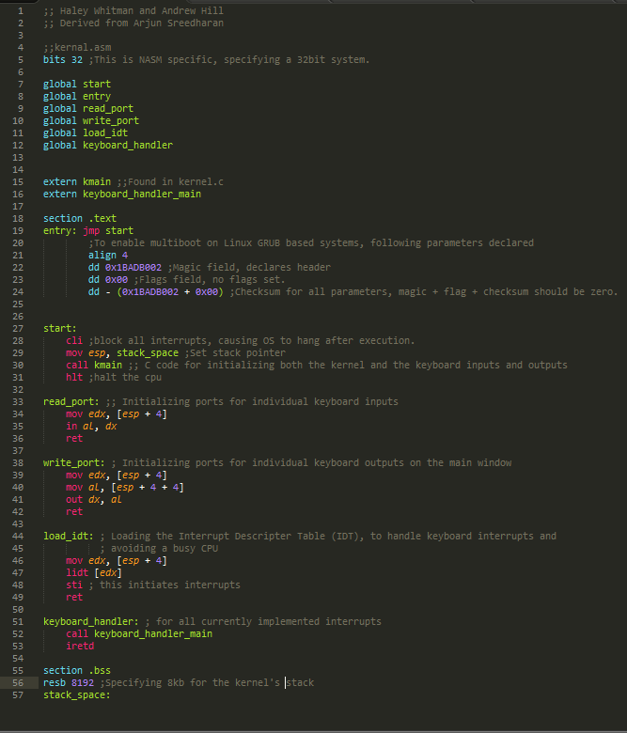
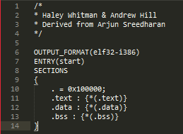
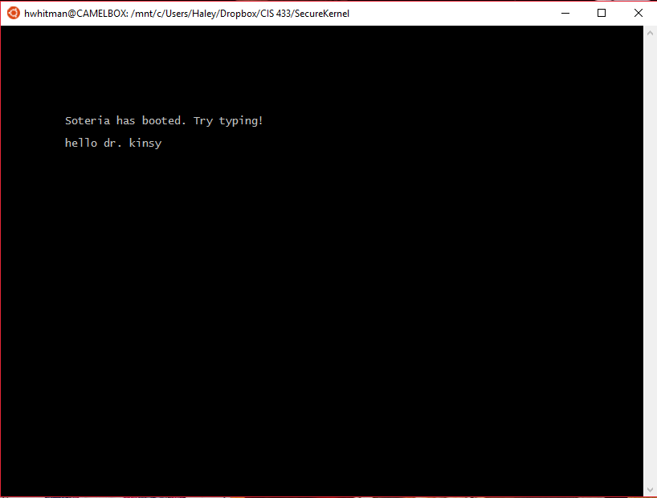
Code examples
These are the current assembly an linker files that are used in initializing the kernel. Kernel running is shown below.
Corresponding kmain.c file not shown.

